Slide 1

PDS Nucleus Trade Study

Slide 2
What is PDS Nucleus?
Current State:
All PDS EN validation, ingestion, and archiving software have their own installations and manual executions.
Future State:
The validation, ingestion, and archival of PDS data is almost entirely automated through a pipeline, minimizing manual overhead. Additionally, the pipeline would be extendable for future additions to the pipeline.
Proposed Task:
Develop an extendable, performant pipeline service to integrate and automate PDS tool execution.

Slide 3
Trade Study Approach
Nucleus High-level Requirements
1) Elimination Process
Shortlisted Products
2) Detailed Comparison
3) Proof of Concept Prototypes
Finalists
Candidate Technologies/ Products
Final Selection

Slide 4
PDS Nucleus - Requirement Analysis
High-level requirements of Nucleus were identified and documented at
https://github.com/NASA-PDS/nucleus/blob/main/docs/requirements/REQUIREMENTS.md
Requirements Categories
Logging and Auditing Requirements
Versioning, Backups and Restore Requirements
Notification Requirements
Scalability and Performance Requirements
Authentication and Authorization
User, Role and Permission Management
Platform Requirements
NASA/JPL Internal User Community and Endorsement
Support, Learnability and External Skill Availability
Data Pipeline Authoring
Data Pipeline Management
Data Pipeline Execution
ETL Operations
Data Pipeline Lifecycle Management
Data Pipeline Triggers
REST based Application Programming Interface (API)
Command Line Interface (CLI)
Python Programming Language Support

Slide 5
Trade Study Approach
Nucleus High-level Requirements
1) Elimination Process
Shortlisted Products
2) Detailed Comparison
3) Proof of Concept Prototypes
Finalists
Candidate Technologies/ Products
Final Selection

Slide 6
Candidate Technologies
 | Candidate Product/Technology | Related URL | Main Contributor(s) | License | Selected for the Detailed Comparison?
1 | CWS (Common Workflow Services) | https://wiki.jpl.nasa.gov/display/cws/Introduction | NASA JPL | Apache-2.0 License | Yes
2 | KDP (Kubernetes Does Pipelines) | https://github.com/NASA-PDS/kdp | NASA JPL | Apache-2.0 License | No
3 | Camunda Community Edition | https://camunda.com/download/ | Camunda | Mainly Apache-2.0 License and MIT License | Yes
4 | Talend Open Studio |  | Talend | Apache-2.0 License and GPLv2 License | No
5 | ETL via Jenkins | https://techblog.livongo.com/jenkins-etl/ | Jenkins Developer Community | MIT License | No
6 | Bonobo | https://www.bonobo-project.org/ | Bonobo Developer Community | Apache-2.0 License | No
Reference with Justifications: https://docs.google.com/spreadsheets/d/1x698Rf5W1V41rojdvgnethT3V096H3K0/edit#gid=1779302909

Slide 7
Candidate Technologies (contd…)
 | Candidate Product/Technology | Related URL | Main Contributor(s) | License | Selected for the Detailed Comparison?
7 | Luigi | https://github.com/Spotify/luigi | Spotify | Apache-2.0 License | Yes
8 | Taskflow | https://pypi.org/project/taskflow/ | openstack | Apache License | No
9 | Apache Airflow | https://airflow.apache.org/ | Airbnb, Apache Software Foundation | Apache-2.0 License | Yes
10 | Pinball | https://github.com/Pinterest/pinball | Pinterest | Apache-2.0 License | No
11 | Cumulus | https://github.com/nasa/cumulus | NASA | Apache-2.0 License | Yes
Reference with Justifications: https://docs.google.com/spreadsheets/d/1x698Rf5W1V41rojdvgnethT3V096H3K0/edit#gid=1779302909

Slide 8
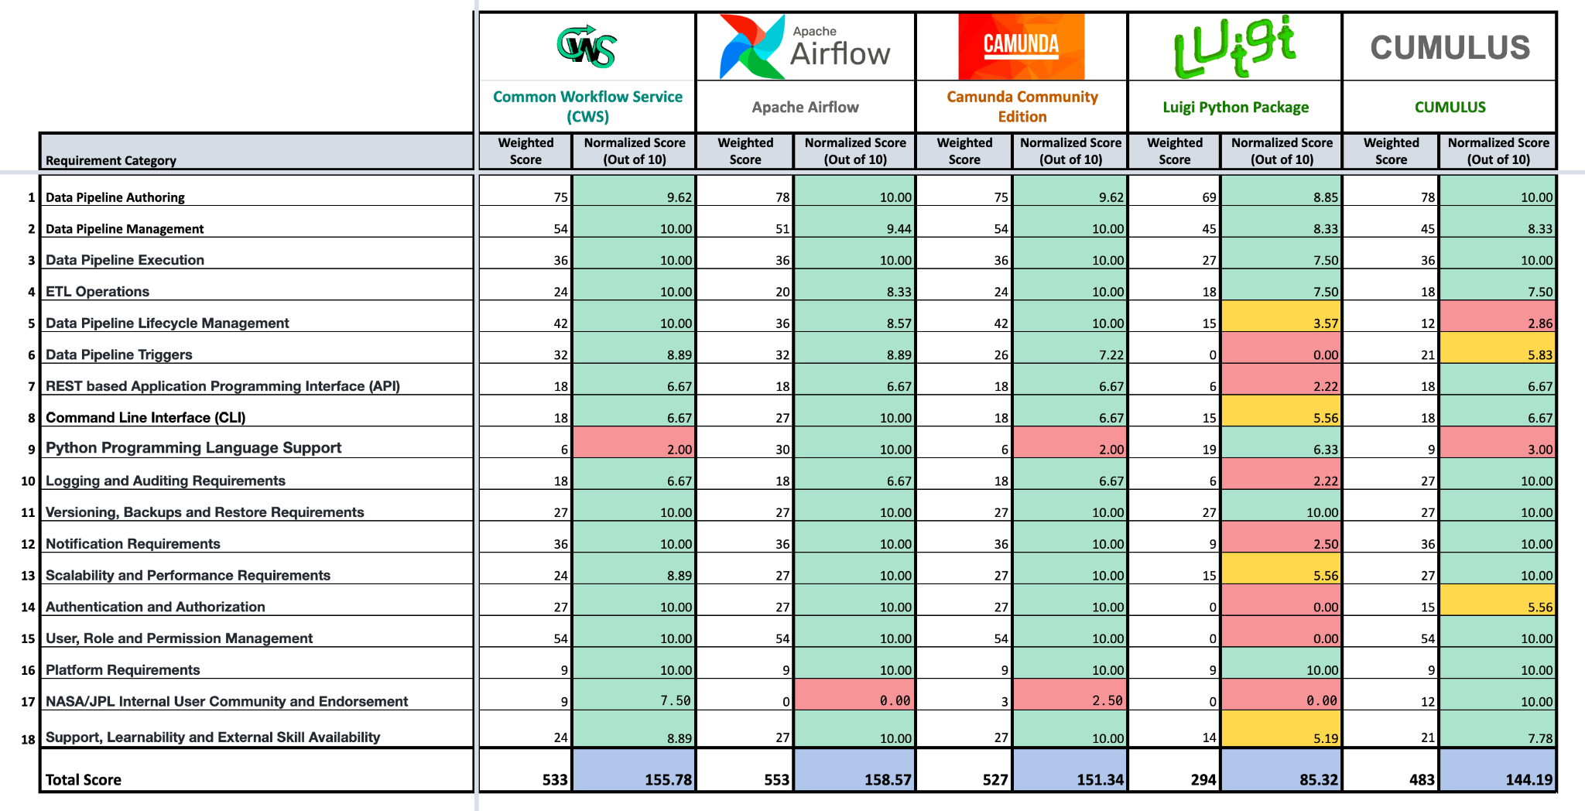
Summary of Product Comparison
Reference: https://docs.google.com/spreadsheets/d/1x698Rf5W1V41rojdvgnethT3V096H3K0/edit#gid=1635527306

Slide 9
Next Steps
Nucleus High-level Requirements
1) Elimination Process
Shortlisted Products
2) Detailed Comparison
3) Proof of Concept Prototypes
Finalists
Candidate Technologies/ Products
Final Selection

Slide 10


Proof of Concept Prototypes
CUMULUS
Common Workflow Services (CWS)

Slide 11
Trade Study Finalists
Product | Weighted Score | Normalized Score
 | 553 | 158.57
 | 533 | 155.78
CUMULUS | 483 | 144.19
Common Workflow Services (CWS)

Slide 12
Use Case for Proof of Concept Prototypes
A PDS Registry use case with following tasks:
Read a PDS bundle from a URL or from an S3 bucket
Execute Validate tool
Harvest data
Load data to Elasticsearch/OpenSearch
Execute integration tests by calling Registry API using a Postman collection
Note: The dockerized Registry components should be used for these proof of concept prototypes

Slide 13
Airflow Prototype

Slide 14
Current Status - Airflow Prototype
Airflow is not cloud dependent and it was possible to setup Airflow on both local developer environment and on AWS (Managed Workflows for Apache Airflow - MWAA)
Local airflow setup status
Successfully executed a Registry use case with
Download Registry data bundle from a URL
Harvest and load data to local OpenSearch
Execute integration test by calling Registry API from a Postman collection
All above steps were executed with Registry docker containers

Slide 15
Current Status - Airflow Prototype (contd.)
Managed Workflows for Apache Airflow - MWAA on NGAP Status
Successfully created a Apache Airflow Environment on NGAP
Completed following Registry use case
Download Registry data bundle from a URL
Harvest and load data to local OpenSearch
Execute integration test by calling Registry API from a Postman collection
All above tasks were executed by utilizing Registry docker containers hosted on Amazon Elastic Container Registry (ECR)
The Airflow was able to execute Registry docker containers through Amazon Elastic Container Service (ECS)

Slide 16
Current Status - Airflow Prototype (contd.)
Airflow on NGAP - Remaining Work
Executing Validate tool as a part of Airflow workflow
Reading files from an S3 bucket was successfully tested as an individual task. It is required to integrate this in to the Registry workflow.
Challenges/problems encountered during the prototype implementation
Unlike local Airflow environment, the Airflow on AWS required many additional security configurations
The simplified DockerOperator is not available on AWS setup. Instead it is required to use ECSOperator with a ECS cluster

Slide 17
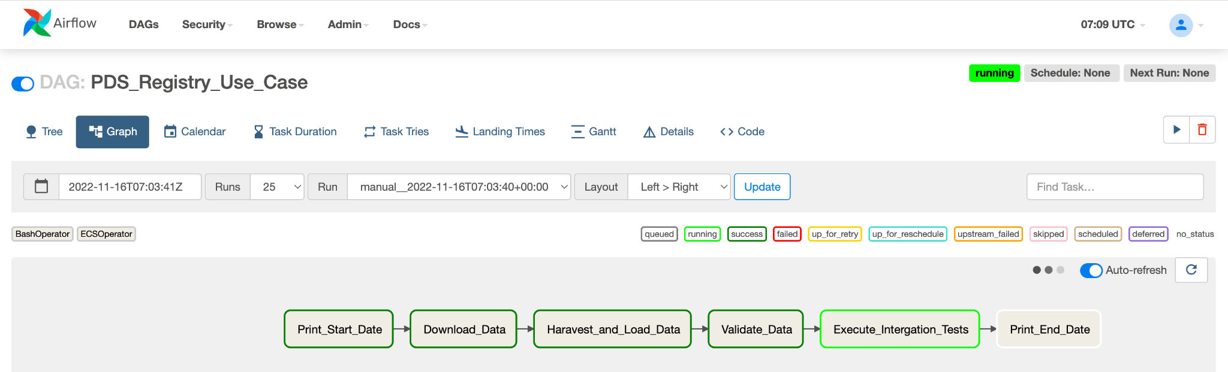
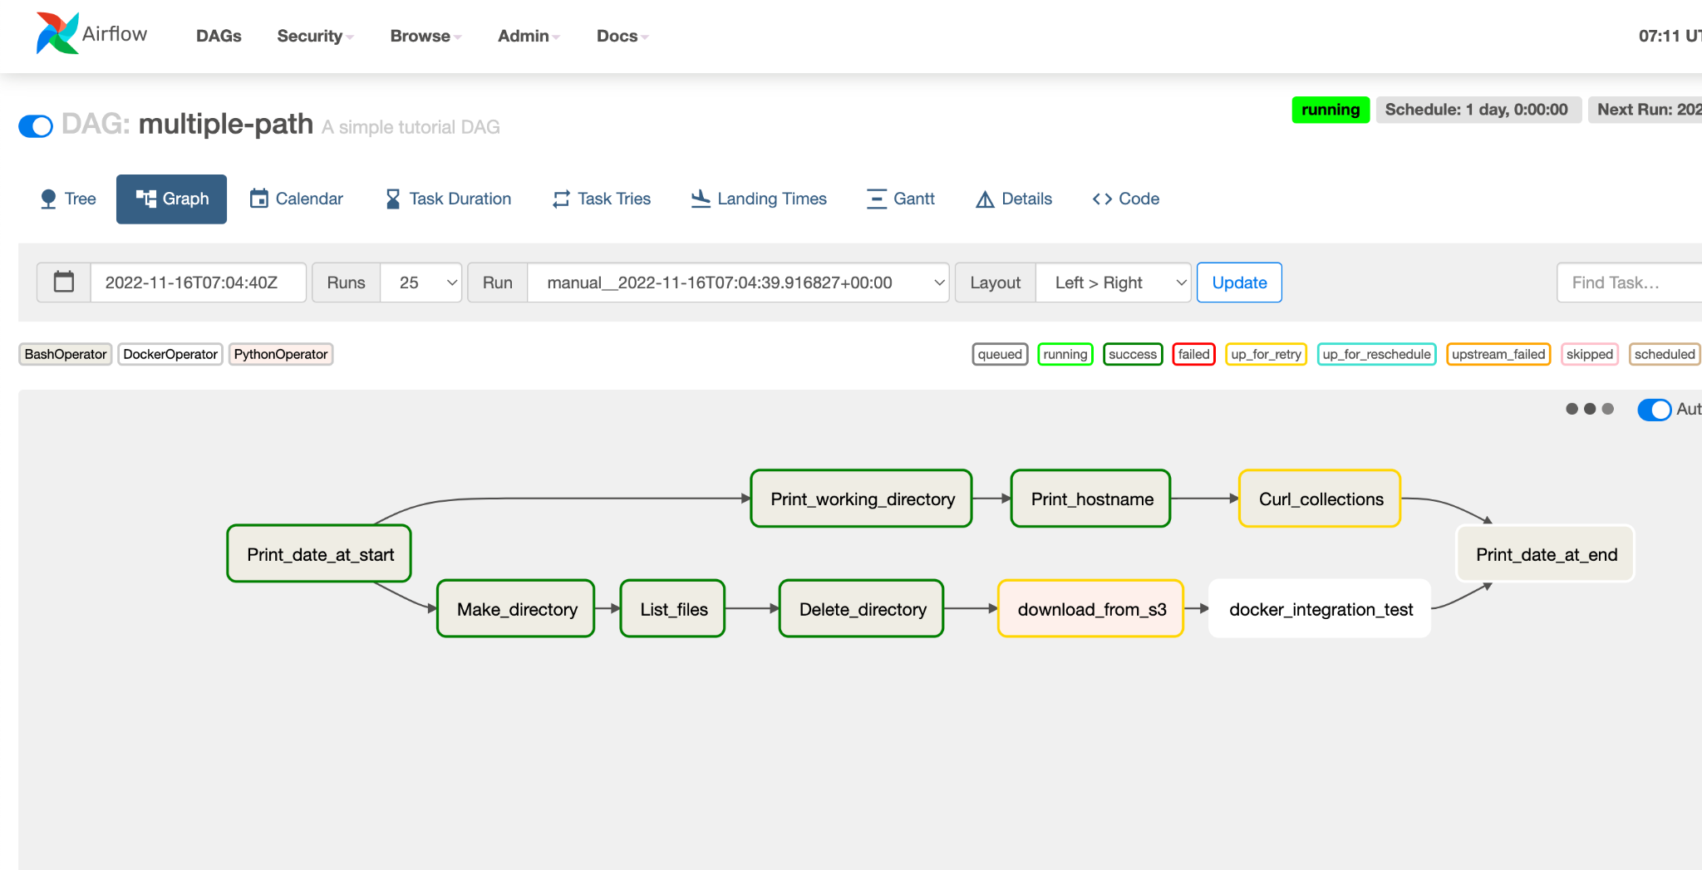
Current Status - Airflow Prototype (contd.)
Note: Validate tool is not integrated yet. The valide task in the screenshot is a placeholder only
Note:
This is a sample workflow that demonstrated the ability run tasks in parallel

Slide 18
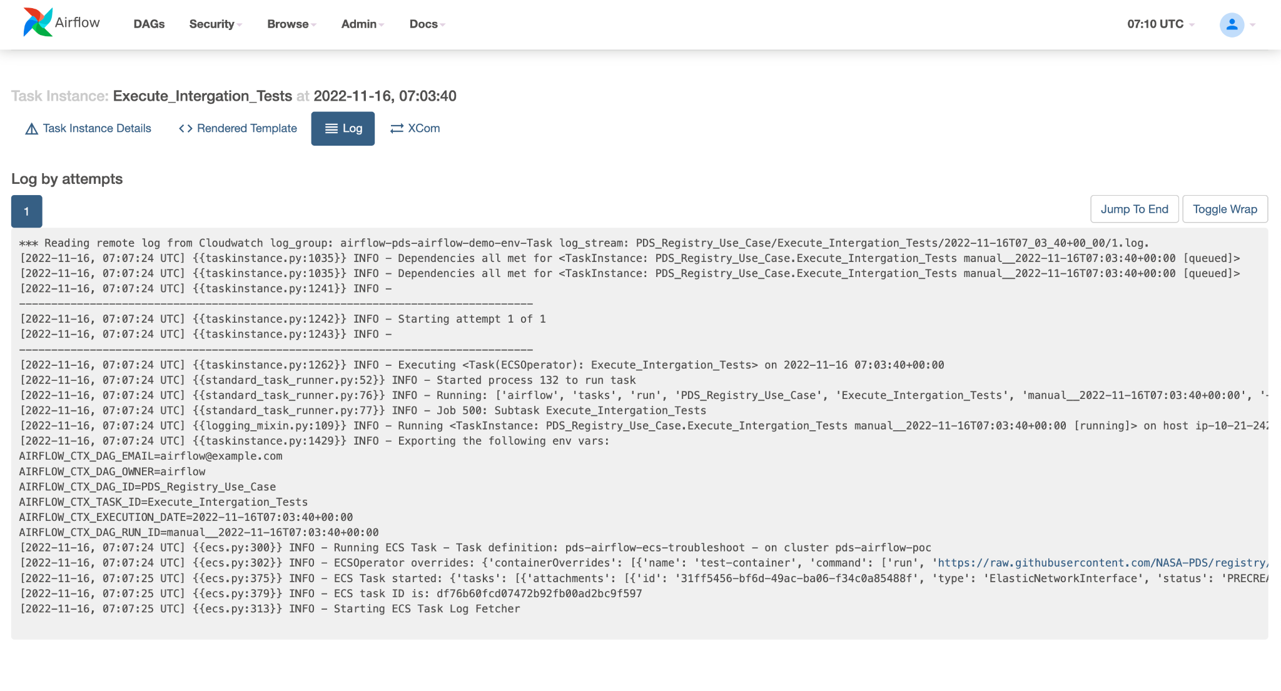
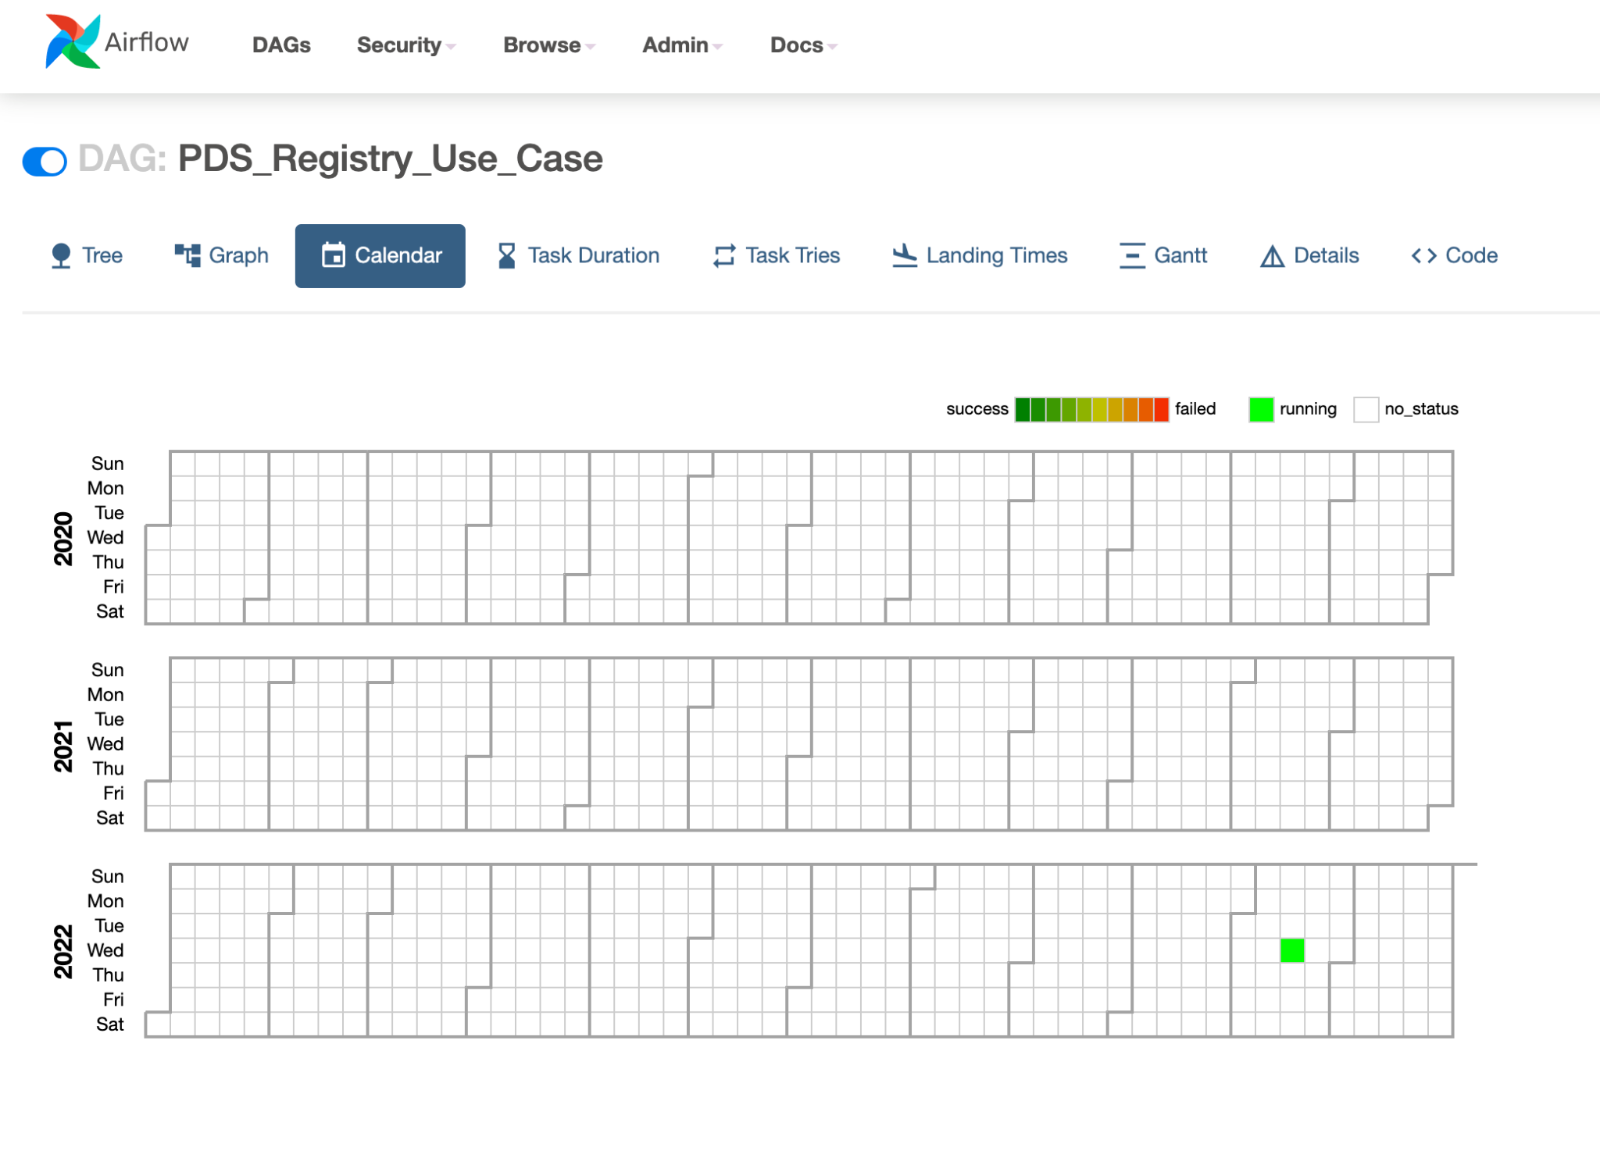
Current Status - Airflow Prototype (contd.)

Slide 19
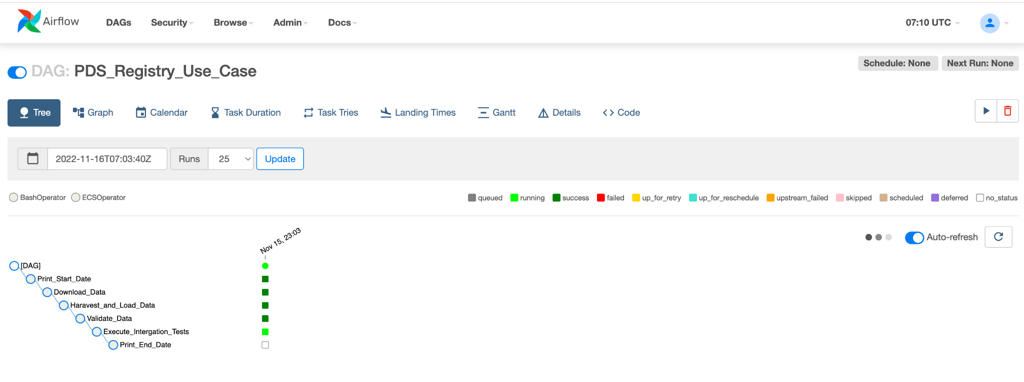
Current Status - Airflow Prototype (contd.)

Slide 20
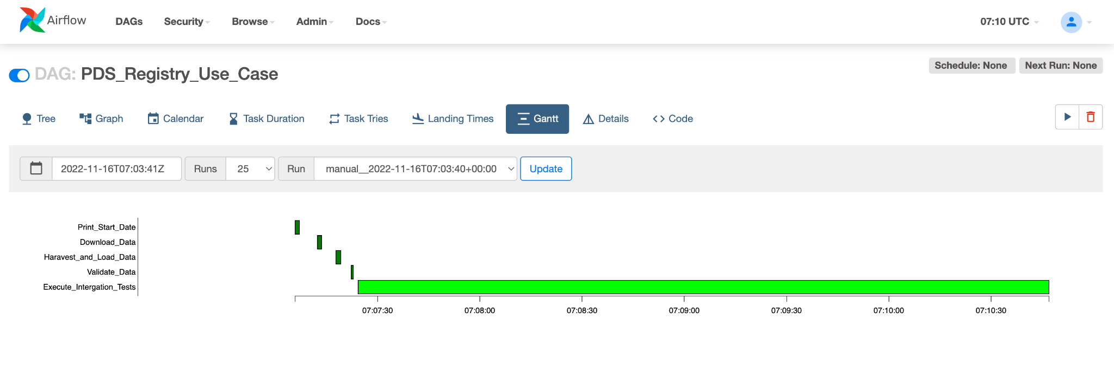
Current Status - Airflow Prototype (contd.)

Slide 21
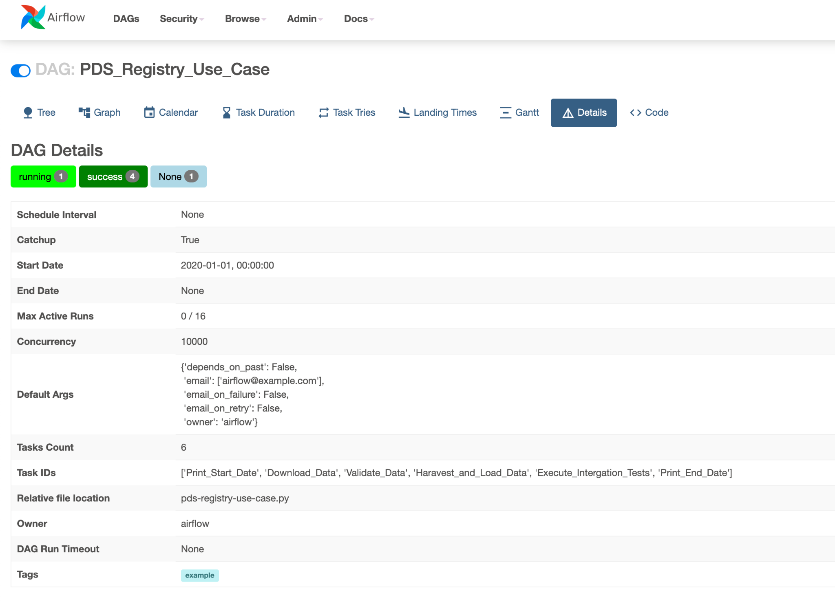
Current Status - Airflow Prototype (contd.)

Slide 22
CWS Prototype
Common Workflow Services (CWS)

Slide 23
Current Status - CWS Prototype
Created initial test workflow in local developer environment to run validate/harvest CLI on sample bundle in CWS (by Scott Collins)
The CWS prototype implementation was started recently
A CWS environment will be setup on NGAP to execute a workflow implementing the selected Registry use case

Slide 24
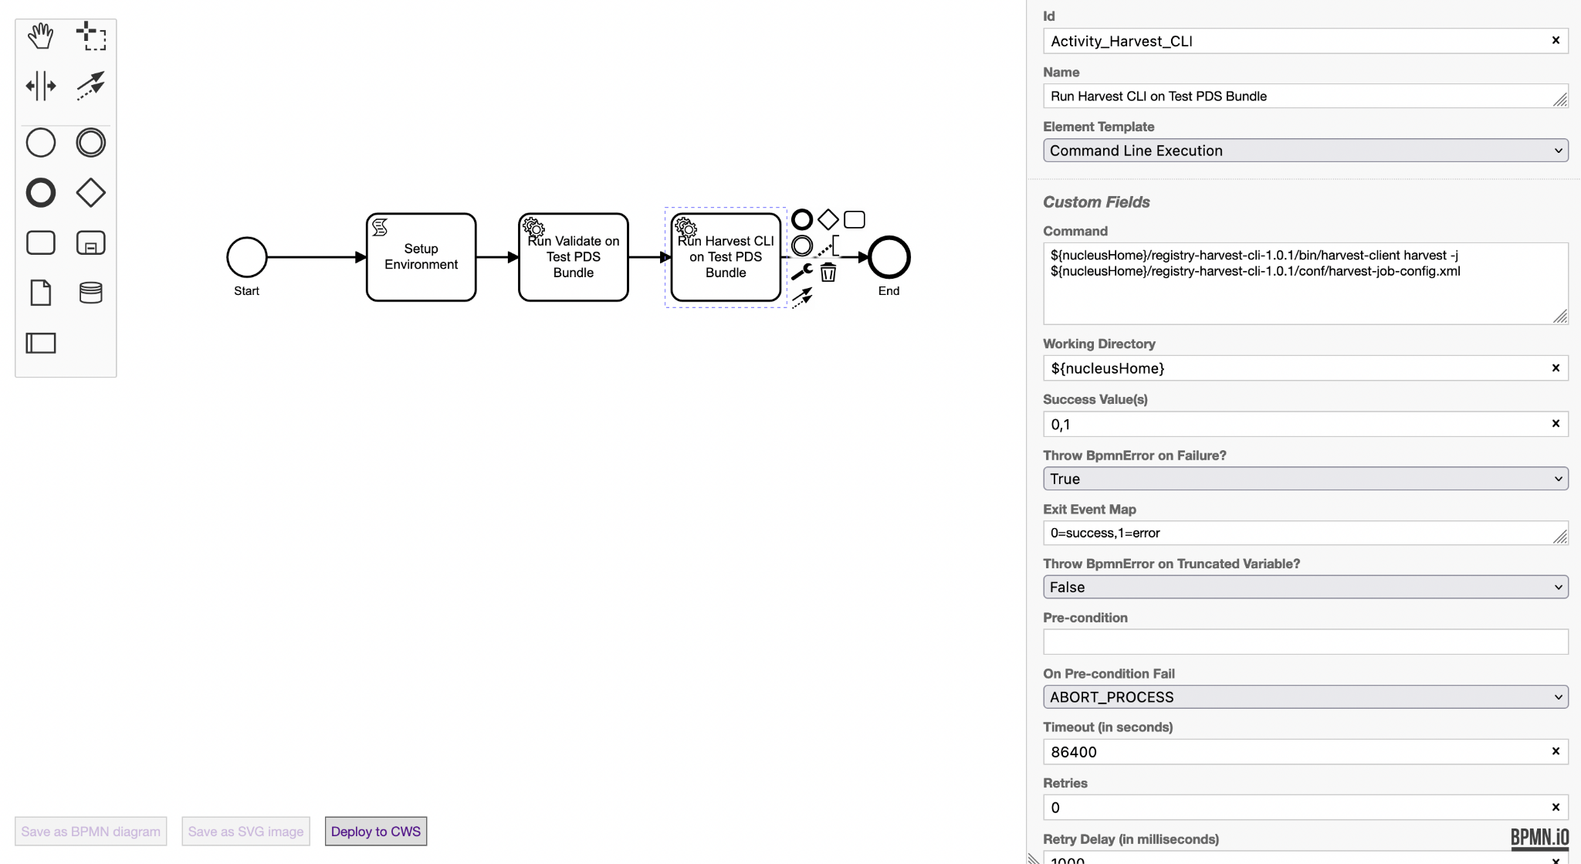
Current Status - CWS Prototype (contd.)
BPMN Model of current workflow from CWS Modeller GUI

Slide 25
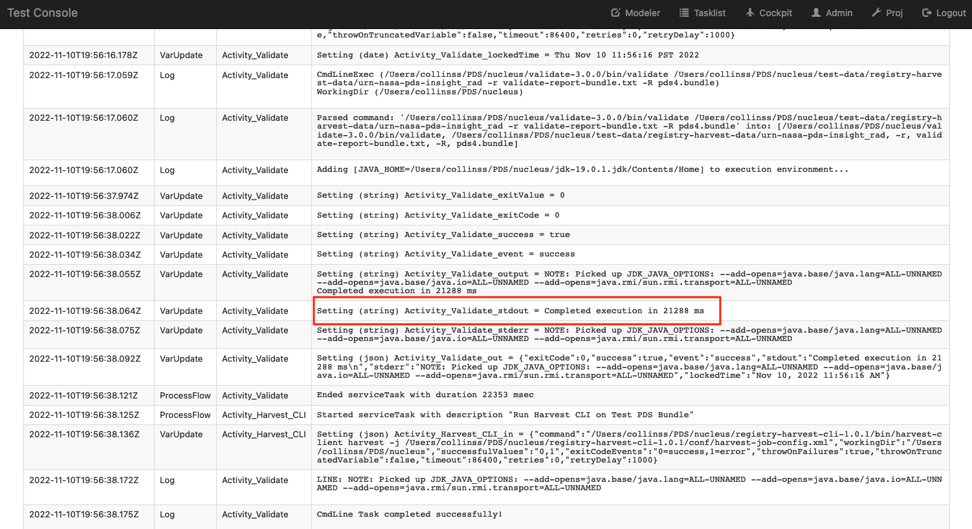
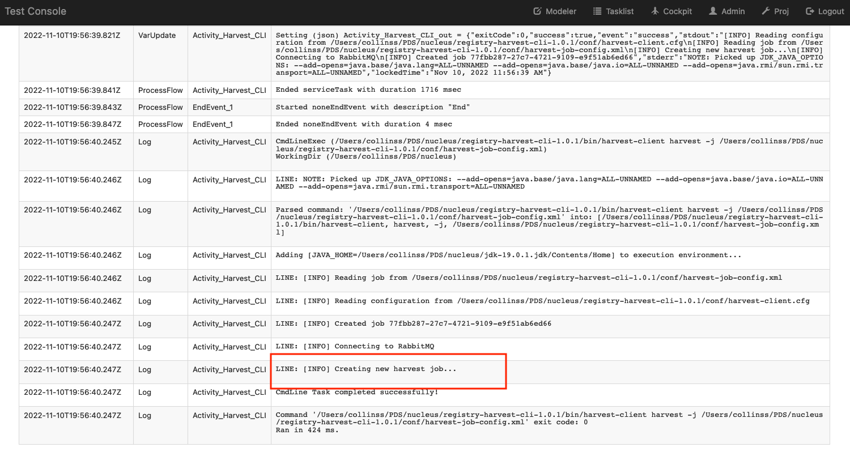
Current Status - CWS Prototype (contd.)
Viewing results of pipeline execution from CWS web console

Slide 26
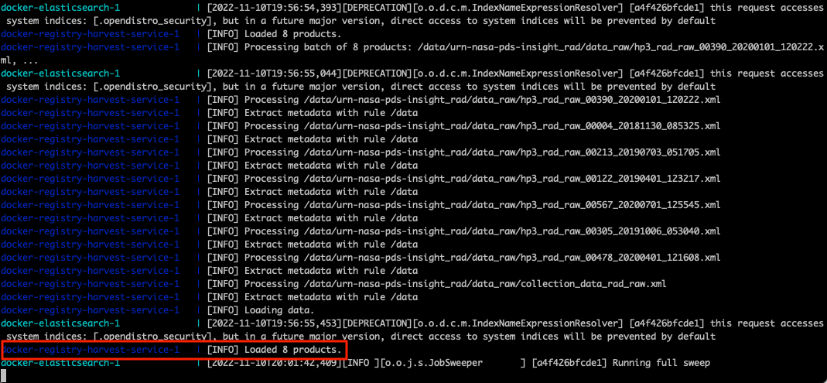
Current Status - CWS Prototype (contd.)
Harvest Server picking up job submitted from CWS pipeline
Server is running outside of CWS via docker-compose config from registry repository

Slide 27
Cumulus Prototype
CUMULUS

Slide 28
Current Status - Cumulus Prototype
Cumulus documentation provides 2 deployment approaches
Fully configurable deployment of Cumulus
Containerized version with Docker
Fully configurable deployment of Cumulus on NGAP
Failed to deploy with AWS permission related errors
Containerized version with Docker
Failed to deploy with AWS permission related errors
Continued troubleshooting deployment error with the help of EOSDIS Evolution and Development (EED-3) representative (from July 2022 to September 2022)

Slide 29
Current Status - Cumulus Prototype (contd.)
Finally, it was decided to get the full support of the EOSDIS Evolution and Development (EED-3) representative to deploy Cumulus with their permissions (first week of October 2022)
The Cumulus server side application was ready and demonstrated (first week of November 2022)
The Cumulus dashboard should be hosted on local developer environment with the current setup. Ideally the Cumulus Dashboard should be hosted on NGAP.
Had a detailed discussion with a Unity project team that uses Cumulus, in order to understand the value additions and pain points related with Cumulus.
Currently studying the Cumulus workflow creation process to implement the selected Registry Use Case with Cumulus

Slide 30
Current Status - Cumulus Prototype (contd.)
Some value additions and pain points shared by the Unity team that uses Cumulus.
Value Additions:
There are several lambda functions available from Cumulus that can reduce the development time related with moving files, archiving etc.
The documentation is well written
There are several existing integrations available with NASA systems such as Earthdata Login and ESDIS Metrics System (EMS)
Cumulus uses an AWS API Gateway integrated with Lambda to enable secure communication
Pain Points:
The data model of Cumulus cannot be directly reused for a new project (E.g: PDS) without introducing updating the Cumulus data model
There is no multiple version support for data files
Processing very large files (50 GB+) with Cumulus lambda function can cause performance issues
The terraform state files should be shared between those who want to deploy a new workflow

Slide 31
Prototyping and Existing User Experience

Slide 32
Current Prototyping and Existing User Experience - Airflow
Product | Weighted Score | Prototyping/Existing User Experience
 | 553 (Rank 1) | Plus Points: Thousand of online resources available online (user guides, videos and forums) helped to accelerate the implementation and troubleshooting Very user friendly Airflow UI with many useful metrics, graphical progress monitoring and charts etc. Workflow execution is independent from the type of data processed Ability to define workflows with a simple python based definitions Ability to control the lifecycle and execution of workflows through the UI and programmatically In-built user access management system Pain Points: Unlike local Airflow environment, the Airflow on AWS required many additional security configurations The simplified DockerOperator is not available on AWS setup. Instead, it is required to use ECSOperator with a ECS cluster

Slide 33
Current Prototyping and Existing User Experience - CWS
Product | Weighted Score | Prototyping/Existing User Experience
 | 533 (Rank 2) | Plus Points: It is easier to find developers and users in JPL, which accelerates the implementation and troubleshooting Workflows are based on the standard Business Process Modeling Notation (BPMN) and has the ability to model workflows graphically Workflow execution is independent from the type of data processed Ability to control the lifecycle and execution of workflows through the UI and programmatically In-built user access management system Pain Points: There were some concerns shared by some users of CWS about the scalability, when trying to execute many parallel workflows (however, some of the these concerns were addressed in the Mars 2020 version of CWS) The graphically generated BPMN models are not very code review friendly, compared to the workflow definitions implemented in programming languages
Common Workflow Services (CWS)

Slide 34
Current Prototyping and Existing User Experience - Cumulus
Product | Weighted Score | Prototyping/Existing User Experience
CUMULUS | 483 (Rank 3) | Plus Points (based on conversations with existing Cumulus users): There are several lambda functions available from Cumulus that can reduce the development time related with moving files, data archiving etc. There are several existing integrations available with NASA systems such as Earthdata Login and ESDIS Metrics System (EMS) Cumulus uses an AWS API Gateway integrated with Lambda to enable secure communication The documentation is well written Pain Points (based on conversations with existing Cumulus users): The data model of Cumulus cannot be directly reused for a new project (E.g: PDS) without introducing updating the Cumulus data model There is no multiple version support for data files Processing very large files (50 GB+) with Cumulus lambda function can cause performance issues Steep learning curve The terraform state files should be shared between those who want to deploy a new workflow Deploying Cumulus is a well known painful experience

Slide 35
Additional References
Detailed Comparison of Candidate Technologies with Scores
https://docs.google.com/spreadsheets/d/1x698Rf5W1V41rojdvgnethT3V096H3K0/edit?usp=sharing&ouid=102247705965510237251&rtpof=true&sd=true
Nucleus Requirements
https://github.com/NASA-PDS/nucleus/blob/main/docs/requirements/REQUIREMENTS.md

